Slide 1
Chapter – 5
Training Center
NIRD&PR

Slide 2
Standard Operating Procedures
Chapter- 1
Introduction
Chapter-3
Project Implementation Procedures
Training
Chapter 7 – Tracking & Placement
Chapter 8 – Project Financial Management
Chapter 9 – Grading of a project &Project implementing Agency
Chapter-4
Training Design & Planning
Chapter – 5
Training Centre
Chapter- 6
Training Initiation

Slide 3
Outline of Chapter 5
OPENING OF TRAINING CENTRE
Look and feel
INSPECTION OF A TRAINING CENTRE
Protocol for inspection of a training center
Others
Protocol for uniform distribution
Due diligence
Daily Monitoring
Protocol for CCTV Monitoring
Assessment and certification
Conducting training outside state

Slide 4
5.1.2 Due Diligence
Item | Description
Purpose | To verify the availability of minimum infrastructure to start the training centre
Prerequisite/s | After project initiation and locating prospective training centre
Time for completion | Before start of training centre and introduction of a new batch/ trade
Resources/s | As per SF 5.1C2: Welcome kit to trainees, SF 5.1D1: Due diligence of training centre (excluding residential facilities) and SF 5.1D2: Due diligence of residential facilities (Pg: 92-134 of SOP)
Process owner | PIA OP team

Slide 5
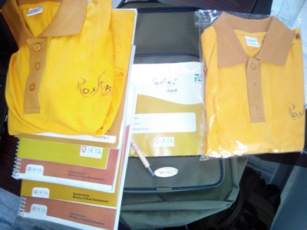
Student Welcome Kit

Slide 6
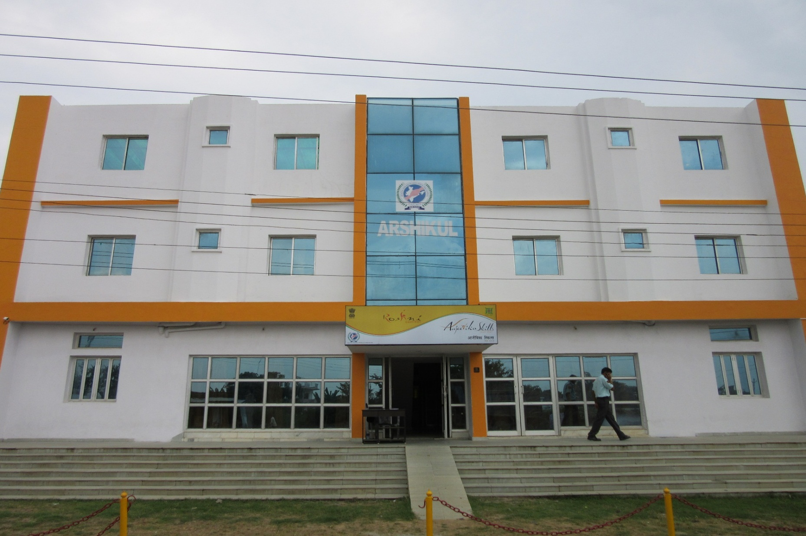
Training Center

Slide 7
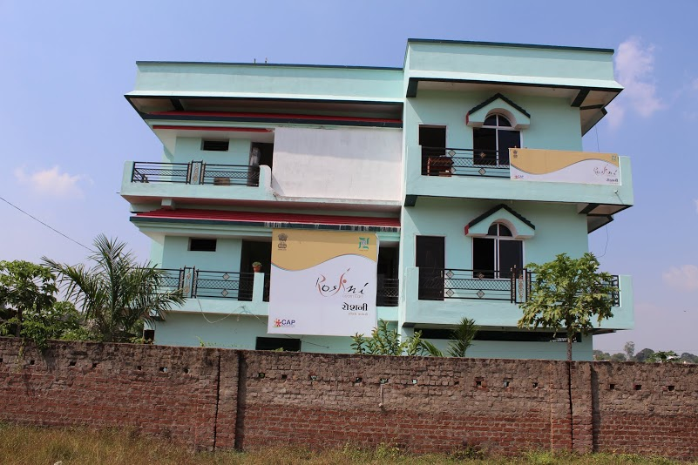
Training Center

Slide 8
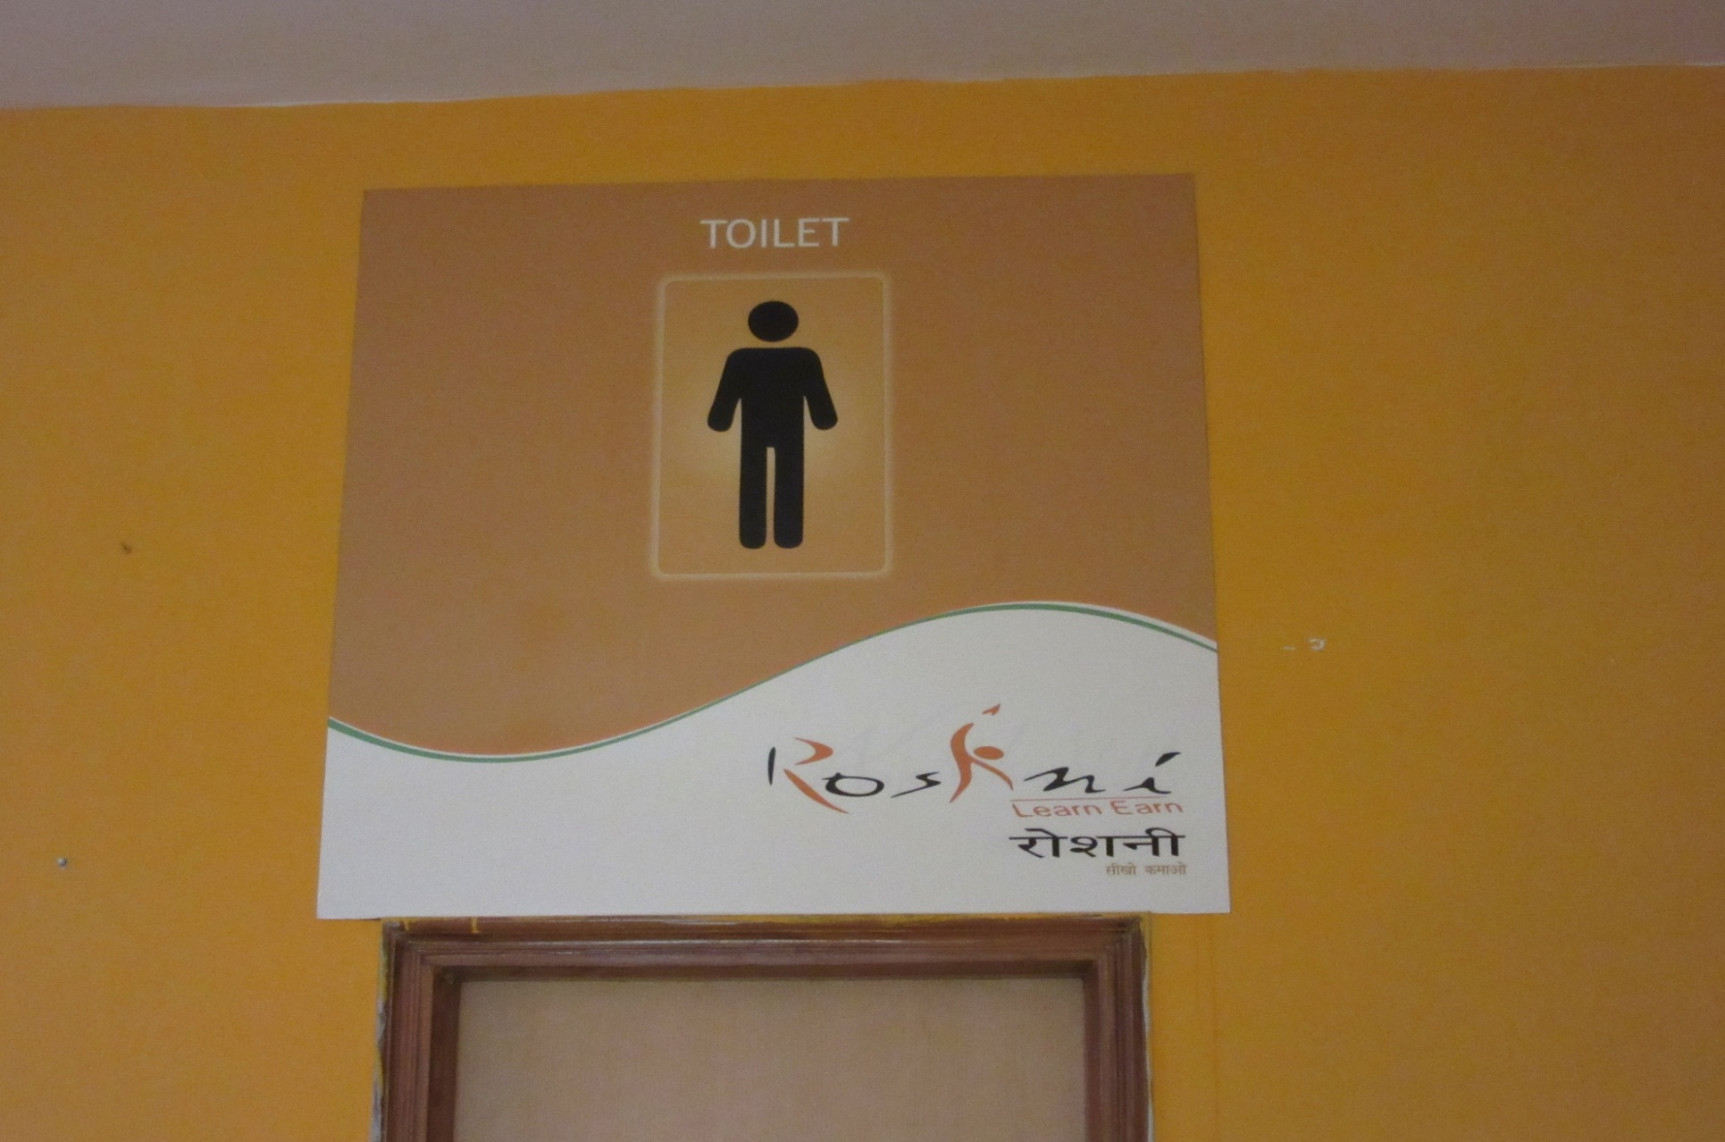
Signage's

Slide 9
5.1 Opening of a Training center

Slide 10
List of parameters verified at the time of due diligence (1/8)
S.No | List of Parameters | Standards
Physical Infrastructure
1 | Ownership of the Building(Own,(O)Rent,(R) Govt (G) | NA
2 | Area of the building (Sq. Ft.) (Including corridors but excluding spaces open to sky such as court yards etc.) | NA
3 | Is it RCC/ Non RCC | NA
4 | If it is non RCC, Whether it is structurally sound on visual inspection | NA
Description of Rooms
5 | Class rooms (in number) | NA
6 | Domain labs (in number) | NA
7 | IT labs (in number) | NA
8 | Reception room | NA
9 | Office room | NA
10 | Counseling rooms (not mandatory – a portion of office room can be used after proper partitioning) | Minimum of 180 sq.ft

Slide 11
List of parameters verified at the time of due diligence (2/8)
S.No | List of Parameters | Standards
Conformance of center to Standards
1 | Visible signs of leakages from walls and roof - applicable for both RCC and Non RCC structures | should not be any visible marks of leakages from walls and roof.
2 | Protection of stairs, balconies, and other locations | Even if one place is unprotected the centre should not be commissioned.
3 | Roof height (state in feet) | 9 ft.
4 | Conformance to DDU-GKY look and feel standards as per sub section 5.1.1 | As per 5.1.1
5 | Circulating area (in sq. ft) | 12 % of the total area.
6 | Corridor width (in feet) | 4 ft.
7 | Toilets (in number) | As per annexure
8 | Washbasins (in number) | As per annexure
9 | Type of Flooring (write whether it is tiled, cemented etc.) | NA
10 | Connection to running water

Slide 12
List of parameters verified at the time of due diligence (3/8)
S.No | List of Parameters | Standards
Location
11 | Distance of the training center to various transport locations | should not be located in a busy market place.
12 | Can the candidates safely come to the center when training is conducted | safe and easily accessible place
13 | Sound level (in dBA) | should not be more than 75 decibels
14 | Open space for people to gather and interact (in sq.ft) | 100 sq.ft
15 | Exclusive parking space ( number in terms of bicycle parking slots) | 5 bicycle parking

Slide 13
List of parameters verified at the time of due diligence (4/8)
S.No | List of Parameters | Standards
Electrical wiring & Standards
16 | Securing of wires | Concealed wiring is not mandatory.
17 | Switch boards and panel boards | Fully covered
Signage's and information Boards
18 | Training center name board (SF- 5.1A2) | NA
19 | Activity summary and achievement board (SF-5.1B1) | NA
20 | Student entitlement banner in English (SF- 5.1C1) | NA
21 | Contact detail of important people (SF- 5.1B2) | NA
22 | Basic Information board | NA

Slide 14
List of parameters verified at the time of due diligence (5/8)
S. No | List of Parameters | Proof of Documents
CCTV
24 | Central monitor easily accessible to center in charge | Photographs
25 | Conformance of CCTV to DDU-GKY as provided in chapter 5 of SOP
26 | Storage of the CCTV recorded material | Photographs

Slide 15
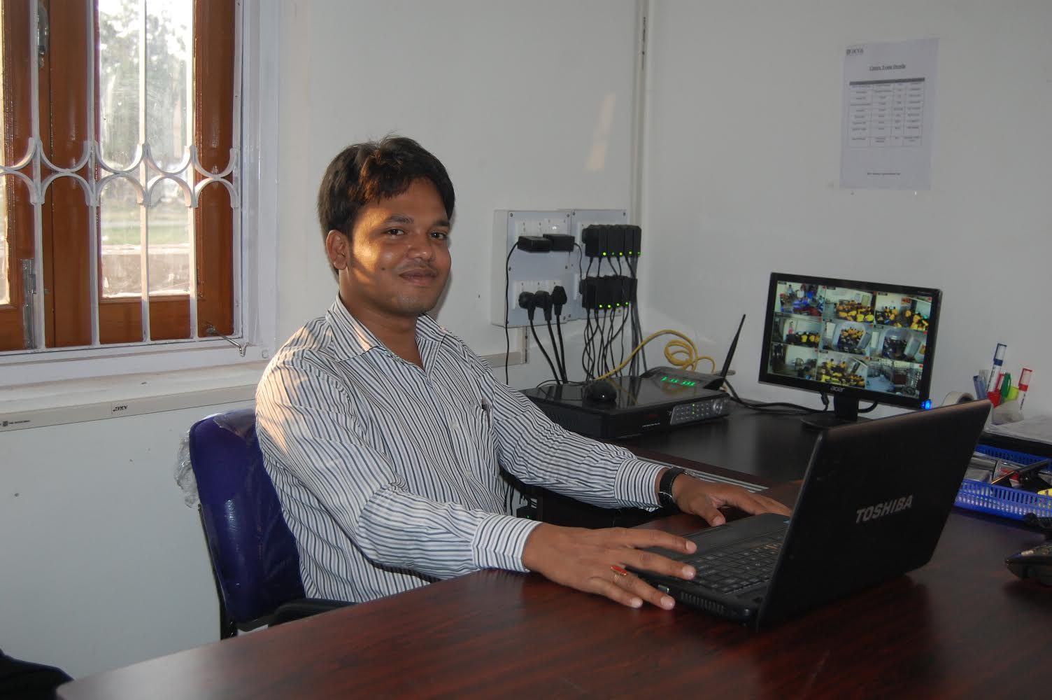
Office room

Slide 16
List of parameters verified at the time of due diligence (6/8)
S. No | List of Parameters | Standards
Physical Infrastructure: Academic & Non Academic
1 | Theory class room 1 | 10 sft.
2a | Window area (in sq ft) | should be minimum 12% of the total floor area
2b | Do the windows have cross ventilation
3 | Class room information board
4 | Office room
5 | Counseling Room
6 | Reception Room

Slide 17
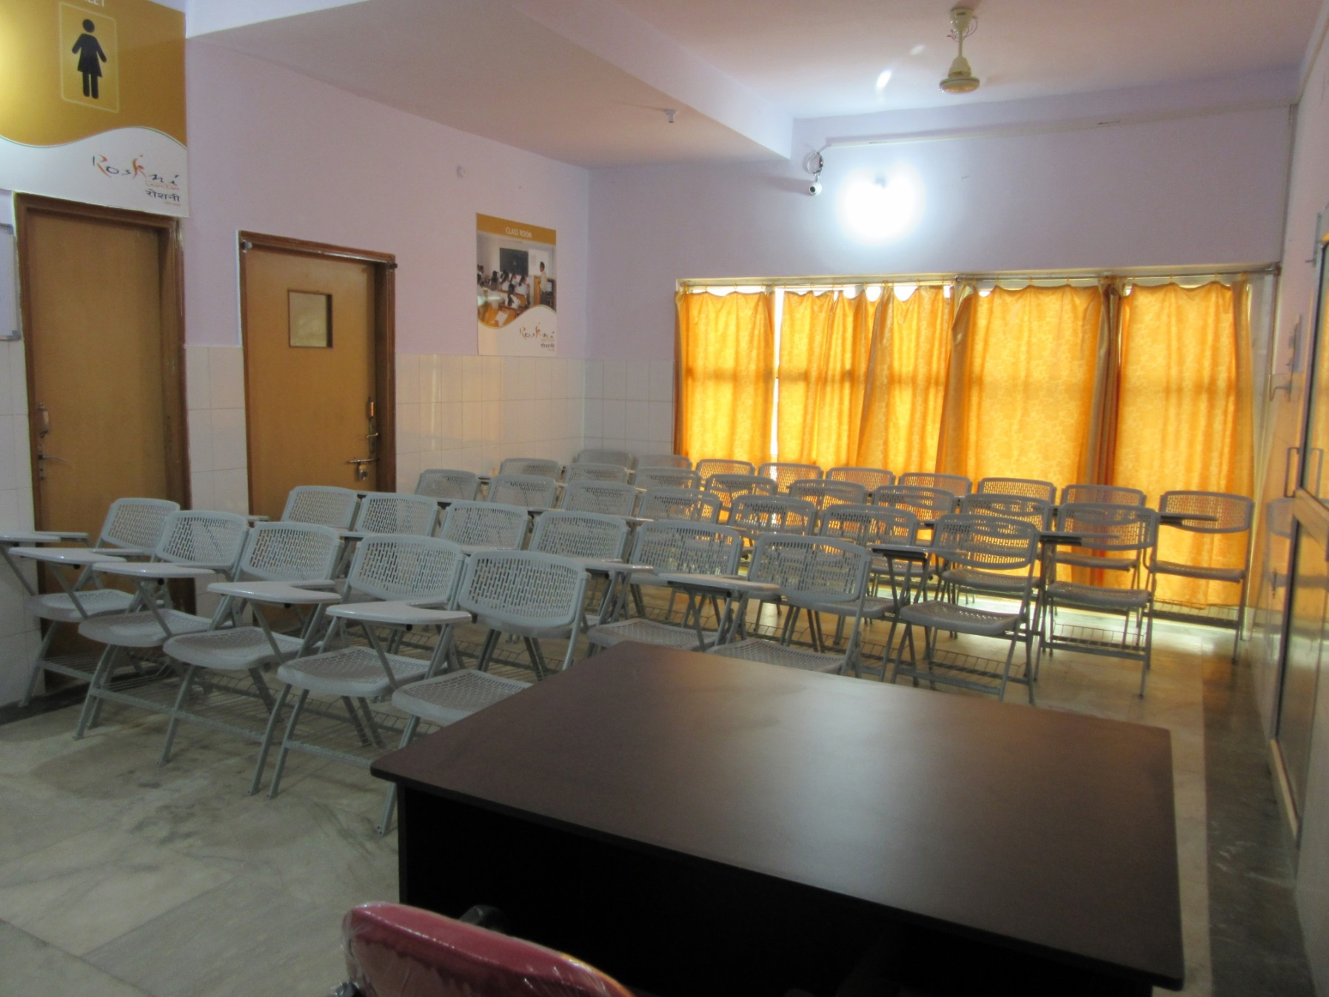
Classroom

Slide 18
List of parameters verified at the time of due diligence (7/8)
S. No | List of Parameters | Standards
Common Equipment
1 | Gensets | should be tested with full load for at least 1 hour
2 | Installation of Biometric devices | As per annexure
3 | Installation of CCTV cameras
4 | Storage place for securing documents
5 | An office table (in number) | 3 by 4 Sq. ft
6 | Chairs (in number)
7 | Table for office computer | 2 by 3 Sq. Ft.
8 | Office computer (in number)
9 | Printer cum scanner (in number)
10 | Digital camera (in number)
11 | Minimum equipment as per SF 5.1P

Slide 19
List of parameters verified at the time of due diligence (8/8)
S. No | List of Parameters | Standards
Equipment - theory and practical class room (excludes domain specific equipment)
1 | CCTV cameras with audio facility | Photographs/Purchase proof
2 | Over Head Projector screen /LCD | screen of 50”
3 | Chair per candidate (in number)
4 | Trainer’s chair
5 | Trainer’s Table | 3 by 4 Sq. Ft.
6 | Writing board | 5 feet X 3 feet.
7 | Lights (in number) | 1 ceiling fan for each 175 sq.ft
8 | Fans (in number) | 1 light for each 175 sq.ft.

Slide 20
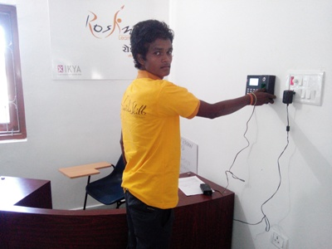
Biometric & Reception

Slide 21
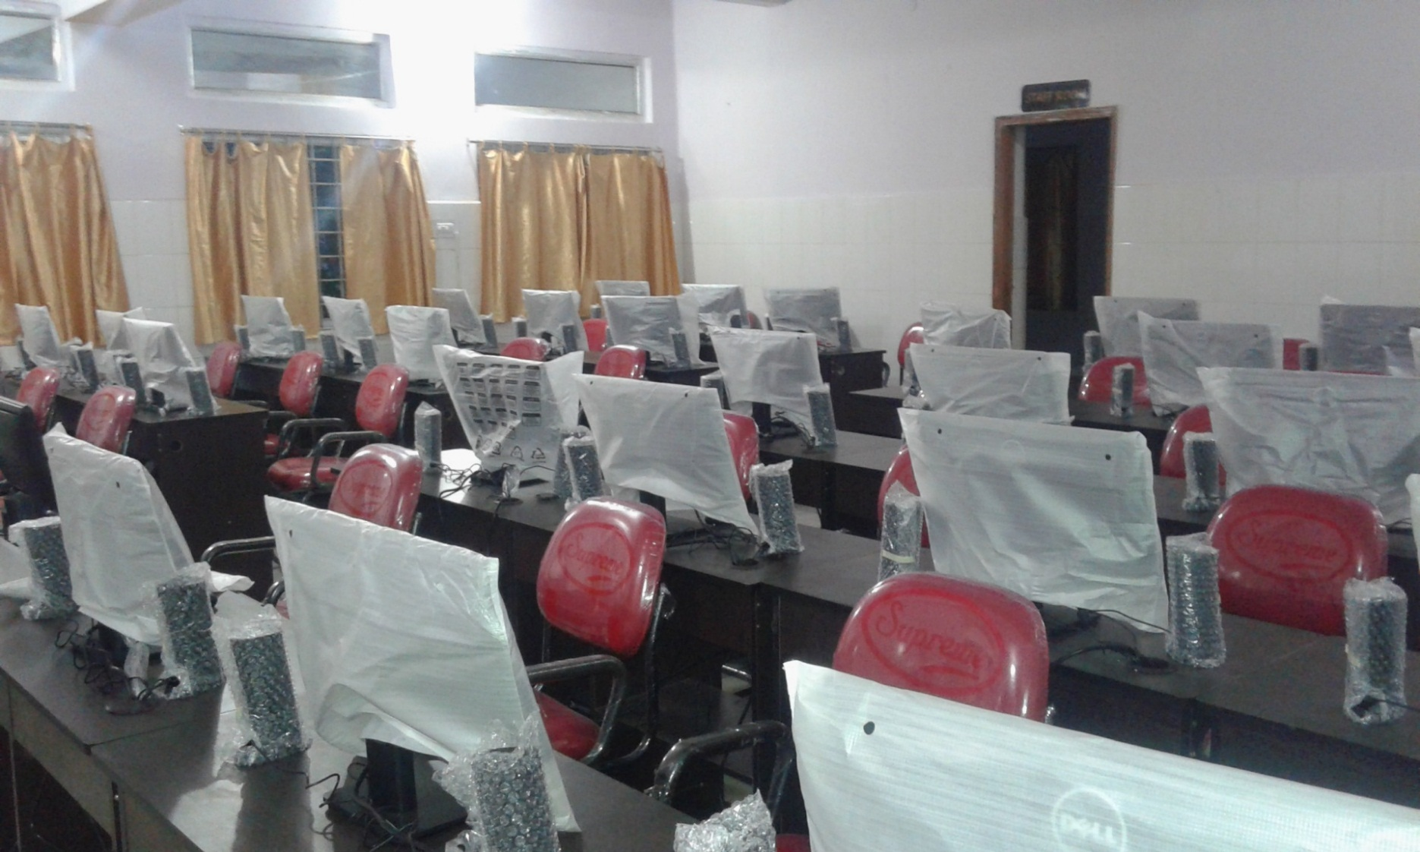
IT LAB

Slide 22
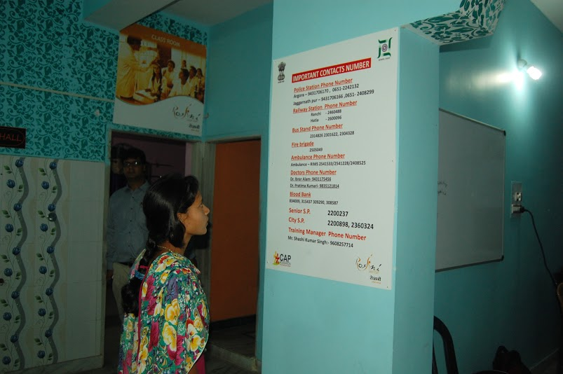
Contact nos. of Important people

Slide 23
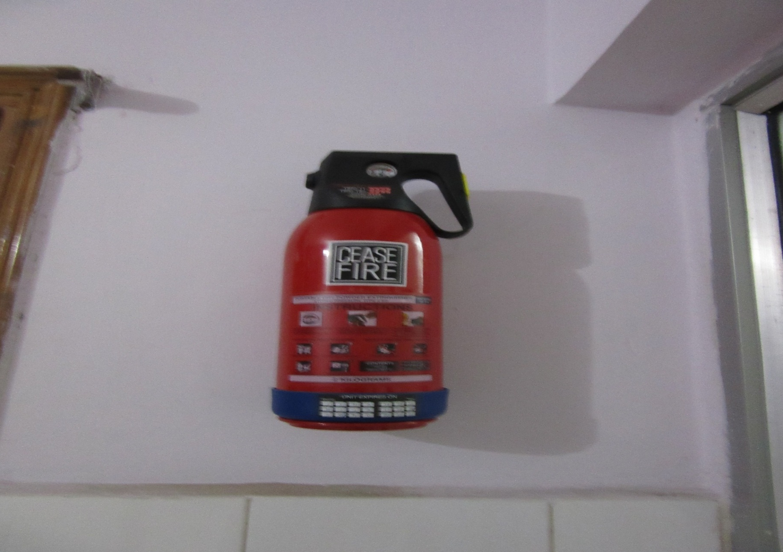
Fire extinguisher

Slide 24
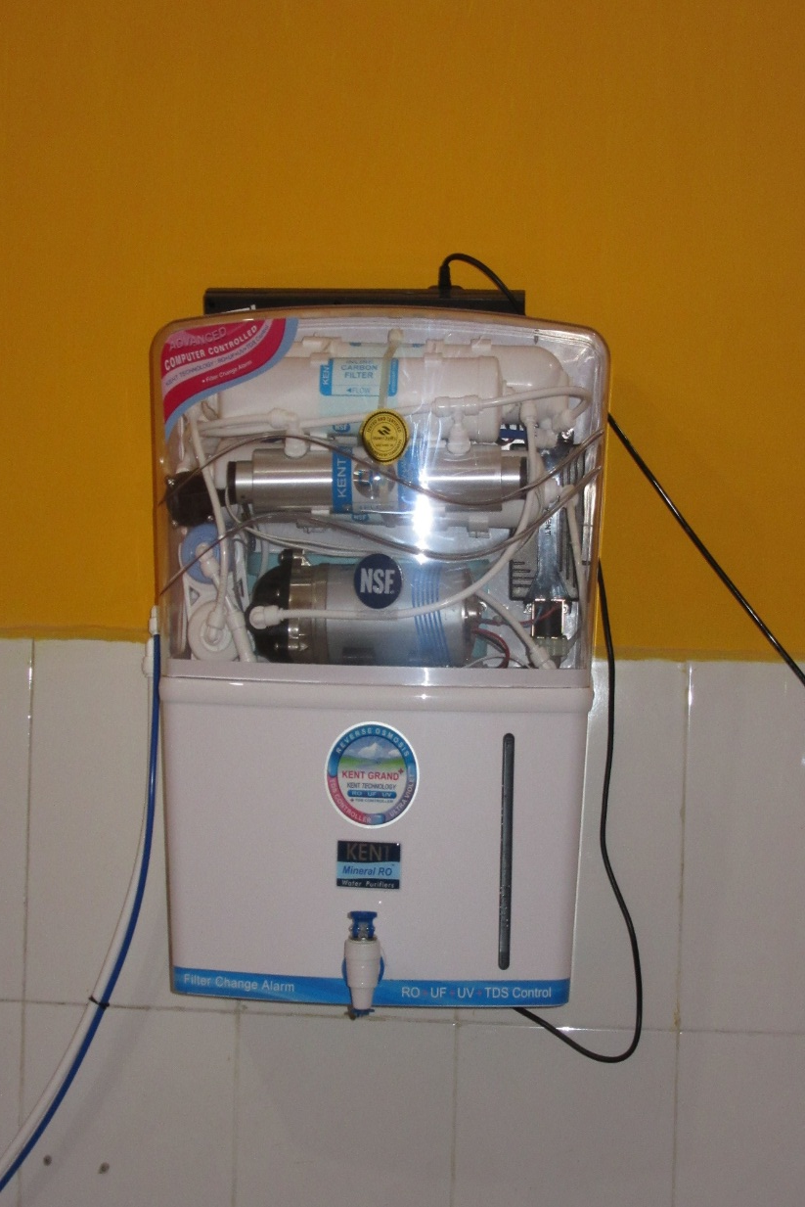
Drinking Water

Slide 25
Due diligence for residential facilities

Slide 26
List of parameters verified at the time of due diligence Residential Training(1/3)
S. No | List of Parameters | Proof of Documents
Details of Residential areas
1 | The size of the room | 25 sft per candidate
2 | Reception area in female hostels for visitors
3 | Window area (in sq ft)
4 | Do the rooms have windows with cross ventilation?
5 | Cot (in number)
6 | Mattress (in number)
7 | Bed sheet (in number)
8 | Cupboard/ almirah with locking arrangements (in number)
9 | No of students permitted in the room

Slide 27
List of parameters verified at the time of due diligence Residential Training(2/3)
S.No | List of Parameters | Proof of Documents
Location
11 | Distance of the training center | Google map snapshot showing the distance
12 | If the training center is more than 1 km, then the availability of pick up and drop facilities | Quality auditors to use their judgment based on city conditions
13 | Can the candidates safely come to the center when training is conducted | Auditor’s judgment. In case of any difference CTSA decision is final.

Slide 28
List of parameters verified at the time of due diligence Residential Training(3/3)
S. No | List of Parameters |  | Standards
Details of Residential
1 | Kitchen area | No min. specifications
2 | Recreation area | 3.3 sq.ft for every inmate
3 | Dining Area | 2.3 sq.ft for every inmate
4 | Number of stools/chairs/benches
5 | Whether TV with a cable or satellite connection is available for viewing
6 | Equipment for indoor games | Min. 4 indoor games
7 | Segregation of hostels for male & female candidates
8 | Warden/care taker for hostels where males stay
9 | Lady warden/care taker for hostels where females stay
10 | Security Guards
11 | Availability of women doctor on call (if female hostel exists)
12 | Availability of men doctor on call (if male hostel exists)

Slide 29
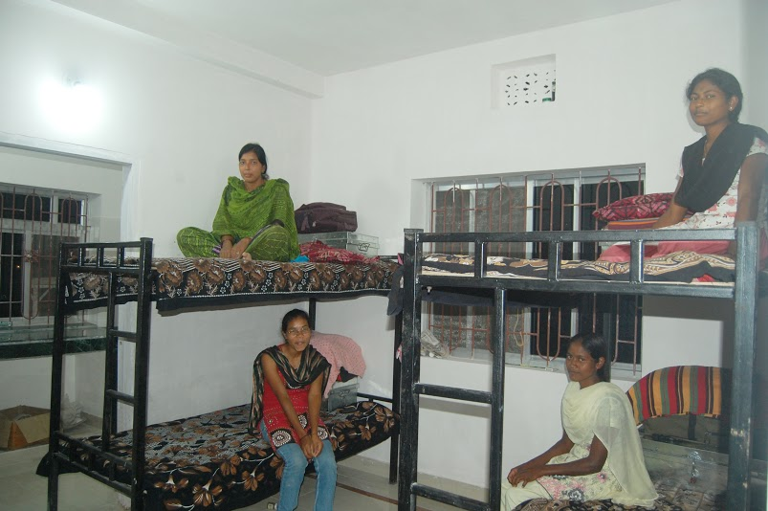
Accommodation

Slide 30
Chapter – 5
Other Aspects of TC
NIRD&PR

Slide 31
5.1.1 Look & Feel
Item` | Description
Purpose | To ensure that all the DDU-GKY training centres across India have distinctive look
Prerequisite/s | After completion of project execution assessment and locating prospective training centre
Time for completion | At least a week before due diligence
Resource/s | As per SF 5.1A1: Look and feel of the training centre, SF 5.1A2: Training centre name board, SF 5.1B1: Activity summary and achievement board, SF 5.1B2: Contact details of important people and SF 5.1C: Student entitlement banner (Pg: 91 of SOP)
Process owner | PIA OP team

Slide 32
5.1.3 Daily Monitoring
Item | Description
Purpose | To ensure proper functioning of training centre and capture details of non-functional equipment, trainer and trainee attendance, and deviations if any from the notified training plan
Prerequisite/s | Filling due diligence report by PIA Q team
Time for completion | On all days when the trainings are scheduled in the centre
Resource/s | SF 5.1R: Daily report on centre status and SF 5.1S: 15 day summary of centre status (Pg: 158-161 of SOP)
Process owner | PIA OP team

Slide 33
5.2 Inspection of Training Center

Slide 34
5.2 Inspection of TC
Item | Description
Purpose | To describe inspection procedures to: ensure compliance of earlier checks check the documentation assess the quality of training and overall performance of training centers
Prerequisite/s | Access to completed: SF 5.1D1: Due diligence of training center (excluding residential facilities) : SF 5.1D2: Due diligence of residential facilities : SF 5.1H1: Batch summary as on day of batch freezing : SF 5.1H2: Candidate wise details : SF 5.1I: Attendance registers for candidates (as per biometric) : SF 5.1J: Attendance registers for trainers (as per biometric) : SF 5.1P: List of equipment in the training centre SF 5.1Q: List of equipment in the trainees’ accommodation facilities (applicable for residential training only) : SF 5.1R : Daily failure items report : SF 5.1S: 15 day summary of centre status
Time for completion | As per the inspection schedule
Resource/s | SF 5.2A: Training centre inspection and as per the SFs listed after the activities table below (Pg: 162-170 of SOP)
Process owner | PIA OP team

Slide 35
Protocol for Inspection of TC
At least a total 13 inspection per year by Q team of PIA, SRLM, CTSA
6 inspections - Q team of PIA
  4 inspections – planned and staggered such that a centre is inspected around 40 days after a batch starts.
  2 inspections – surprise visits (modules will be verified)
4 inspections – SRLM for AAP/ CTSA for Non AAP
  2 inspections – Detailed visit
  2 inspections – surprise visits (modules will be verified)
3 inspections – CTSA for AAP & Non AAP
  1 inspection – Detailed visit
  2 inspections – surprise visits

Slide 36
Protocol for CCTV

Slide 37
CCTV : Location & Recording
Specifications
No technical specifications are prescribed for the time being for CCTVs to be procured for the training centres.
However, on replay visual images and sounds should be identifiable easily.
Location and recording
The systems should be located such that all the important areas of training centre related to academic instruction, assessment and marking of attendance are recorded.
In addition to covering the training areas, cameras should be placed such that all important events in training including uniform distribution, tablet distribution etc. are covered.

Slide 38
CCTV : Storage of data
Storage
Nomenclature of Footage - PRN no., Project Code as per MIS, State (name), TC (name only first 3 alphabets), Batch no. (),
For eg. PRNNoProjectCodeStateTCASMO
Sampled video footage should be stored either till E₆ (training completion) + three months or till the project is closed (in case of early closure) - whichever is earlier. Rest of the videos should be stored for three and half months after a batch is completed.
All CCTV footage should be stored in the training centre till the inspection schedules specified for the batch are completed. Sampled video footage, in addition to being stored safely, will be uploaded to the ERP system and also on PIA website..

Slide 39
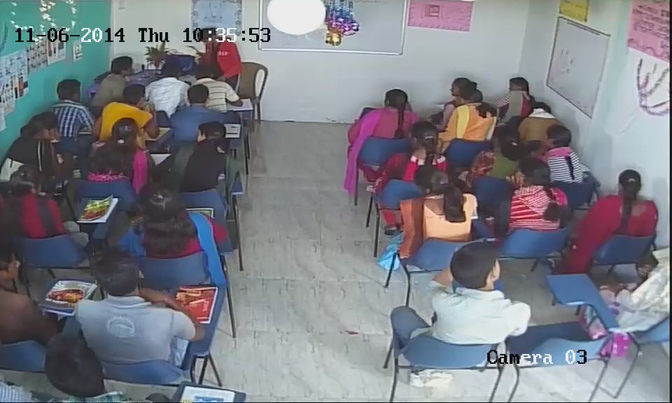
Screenshot of CCTV video footage

Slide 40
Protocol for uniform

Slide 41
Uniform distribution
Item | Description
Prerequisite | Freezing of batch
Purpose | To generate a distinct identity and a sense oneness amongst the candidates
Time for completion | To be distributed with the welcome kit
Resources | As per SF 5.3A: Specifications for uniform and SF 5.1K: Checklist of items given to candidates (Pg-173 of SOP)
Process owner | PIA OP team

Slide 42
Choice & Distribution of Uniform
Choice of uniform - One pair of uniform shall consist of one cap and any of the following
Two T-shirts
Two jerseys
One T-shirt and one jersey
Two sets of Salwar, Kameez and Dupatta
Distribution of uniform
One pair – 3 & 6 months
Two pairs – 9 & 12 months
(Pg-173)

Slide 43
Assessment & Certification

Slide 44
5.4 Assessment & Certification
Item | Description
Purpose | Outline procedures for assessment and certification of candidates
Prerequisite/s | Admission of a candidate to a batch
Time for completion | 1. Internal assessment: Continuous during the training 2. External assessment: Assessment to be done in the last ten days of training by an agency accredited by NCVT/SSC
Resource/s | SF 5.4A: Assessment and certification of candidates, assessment tests and question banks (Pg 174-175 of SOP)
Process owner | PIA OP team

Slide 45
Assessment & Certification
(Refer to sub section - 4.7 & 5.4 )
 |  | Has a candidate cleared the assessment test?
 |  | Yes | No
Whether a candidate has eligibility criteria prescribed by NCVT/SSC? | Yes | Category 1: Will get the certificate from NCVT/SSC | Category 3: Only course completion certificate from PIA
 | No | Category 2: Will get certificate from assessing body | Category 4: Only course completion certificate from PIA
All category 1 and 2 students who complete 3 months of placement will get Aajeevika skills certificate from MoRD.

Slide 46
5.5 Conducting training outside of state – Implementation
At least to train 200 candidates
At least 60 days before the training commences – submission of the list of training centres and their addresses
Submission of proofs of due diligence carried out already.
Pg (88-89 of SOP)

Slide 47
5.5 Conducting training outside of state – Monitoring
Training Centre within 100 km from state: No change in the monitoring agency
Training Centre outside 100 km from state : CTSA will be the monitoring agency
  In case of AAP state :
    Same TC/Trade – CTSA will consider SRLM report.
    Different TC/Trade – Separate due diligence will be conducted by CTSA
    Monitoring fee will be charged accordingly i.e. 1%
  In case of Non AAP state : CTSA will be monitoring the TC

