Slide 1
Chapter1- Introduction
NIRD & PR

Slide 2
Standard Operating Procedures
Chapter- 1
Introduction
Chapter-3
Project Implementation Procedures
Training
Chapter 7 – Tracking & Placement
Chapter 8 – Project Financial Management
Chapter 9 – Grading of a project &Project implementing Agency
Chapter-4
Training Design & Planning
Chapter – 5
Training Centre
Chapter- 6
Training Initiation

Slide 3
Outline – Chapter1
Outline of the Manual of SOP
Navigation of the Document
Applicability & Changes in Guidelines and SOP
Applicability of SOP
Remedy & Action for Delay
Delay by PIA in Non-AAP States
Version control
Implementation process
Important events in a project and their timelines
Delay by PIA in AAP States
Delay by CTSA for Non-AAP states/SRLM for AAP States
Procedure to be followed to impose the penalty
Roles & ERP
District Administration
Village Level Organization
Gram Panchayat
Approach to quality
ERP Platform and interim arrangement

Slide 4
Navigation of Document(1/2)
DDU-GKY Project activities are grouped into modules
Each module has been assigned a chapter and every item of the module has been detailed in separate sub-sections of the chapter
For Eg:
5. Training Center
5.1 Opening of a Training Centre
5.1.1 Look and Feel of a training centre
(if 5.1 has three forms they would be SF 5.1A, SF 5.1B SF 5.1 C)
Sub-forms under SF5.1A are numbered as SF 5.1A1, SF 5.1A2
SF- STANDARD FORM (located at the end of each chapter as per sequence of appearance in the chapter )

Slide 5
Navigation of Document(2/2)
Most sub-sections are divided into two tables. The first table “overview” gives basic understanding of the procedure and second table “Activities” which brings out how the work to be completed.
Table1(overview) Table2 (Activities)
Item | Description
Purpose
Reference to Guidelines
Prerequisite/s
Time for completion
Resource/s
Process owner
Actor | Action | Time for completion | Relevant Documents
PIA OP team
SRLM
CTSA

Slide 6
Applicability & Changes in Guidelines and SOP(1/1)
Applicability:
SOP applicable to all DDU-GKY and Roshni Projects operational in AAP and Non-AAP states
Implementation Process:
PIA have adhere to DDU-GKY guidelines and the standard operating procedures (SOPs)
If PIA is unable able to implement the project, initiate for mutual discussion as per section 4.3(ii) of MoU
Version Control:
All changes in Guidelines and SOP will be systematically tracked and monitored through a version control system.(SF-1.3A Page No.13)

Slide 7
IMPORTANT EVENTS IN A PROJECT AND THEIR TIMELINES(1/2)
Phase | Code | Major Event | Indicative time gap between the events
Inception phase | I₁ | Uploading of approved EC minutes | 0 day
 | I₂ | Uploading of Sanction order | 15 days after I₁
 | I₃ | Execution of Memorandum of Understanding (MoU) | 20 days after I₂
 | I₄ | Release of 1st instalment and issue of Project commencement order | 10 days after I₃
 | I₅ | Submission of project execution readiness form | After I₁ to a maximum of 15 days after I₄

Slide 8
IMPORTANT EVENTS INA PROJECT AND THEIR TIMELINES(2/2)
Phase | Code | Major Event | Indicative time gap between the events
Execution phase | E₁ | Commencement of project | 30 days after I₄.
 | E₂ | Notification for release of 2nd instalment | As per prospective work schedule
 | E₃ | Release of 2nd instalment | 60 days after E₂
 | E₄ | Notification for release of 3rd instalment | As per prospective work schedule
 | E₅ | Release of 3rd instalment | 60 days after E₄
 | E₆ | Completion of training | As per prospective work schedule
 | E₇ | Completion of placement | As per prospective work schedule but not later than 4 months after E₆
 | E₈ | Release of 4th instalment and official closure of the project | 14 months after E₇
Note: Days, unless explicitly stated differently, refers to working days as defined in MoRD calendar. However, when the reference is in months it would be in calendar months.

Slide 9
REMEDY FOR DELAY(1/2)
Delay by | Notice1 | Notice2 | Notice 3
PIA (Non-AAP) | By CTSA within 5 days | By CTSA after 5 days of the first notice ( if the work is not completed) and advise MoRD to take action | MoRD waits for 20 days after issue of first notice, if work is not completed, take action for completion of work and invoke conditions for default
PIA (AAP State) | By SRLM within 5 days | By SRLM after 5 days of the first notice ( if the work is not completed) and inform MoRD | SRLM waits for 20 days after issue of first notice, if work is not completed, take action for completion of work and invoke conditions for default

Slide 10
REMEDY FOR DELAY(2/2)
Delay by | Notice1 | Notice2 | Notice 3
CTSA for non AAP State | By MoRD within 5 days | By MoRD giving 5 days to take further action in the process | MoRD waits for 20 days after issue of first notice, if work is not completed, take action for completion of work and invoke for penal action.
SRLM for AAP State | By MoRD within 5 days | By MoRD giving 5 days to take further action in the process | MoRD waits for 20 days after issue of first notice, If state does not respond: 1. Regulate the flow of funds 2. AAP status will be reviewed by MoRD

Slide 11
Action for Default (1/3)
Reasons for Default :
Shortfall in achievement of target
b) Non Compliance
c) Fraudulent Practices
Concurrent monitoring and advisory system to be put in place through ERP based interactive workflow system.
If PIA fails to perform/take remedial action, invoke penal action under default

Slide 12
Action for Default (2/3)
Classification of Penalties to be imposed:
Category | Penalty (indicative list)
Minor | Fine up to Rs. 25,000 per occasion Retraining candidates without any additional payment to PIA Closing of training centre/s Reduction of targets
Major | Closure of the project Black listing of PIA in the state Black listing of PIA in the country
Note: While imposing the penalties a competent authority can impose any of the penalties listed above that penalty. E.g. - While imposing major penalty of closure of the project a fine also can be imposed.

Slide 13
Action for Default (3/3)
 | Category | Imposing Authority | Appellate Authority
AAP | Minor | COO/Skills, SRLM | Head, SRLM
 | Major | Head, SRLM | Principal Secretary, RD, State Government However for blacklisting across the country approval of MoRD will be required
Non-AAP | Minor | Joint Secretary (Skills) | Additional Secretary in charge of Skills at MoRD
 | Major | Joint Secretary (Skills) | Additional Secretary in charge of Skills at MoRD

Slide 14
Role of District Administration (1/1)
Functions of DMMU:
Mobilization
Facilitating the PIAs during mobilization of candidates
Counseling sessions of parents with the trainers about the benefits of the program.
Identify Potential centers for Job fairs and submit a budget to SRLM to include in Annual Action Plan State/Yearly Plan. )
Placement and Tracking
Tracking Details to be uploaded on the designated weblink by DMMU
Capacity Building for Sub-district functionaries
Periodic workshop to be organized for VLO and BDOs about DDU-GKY

Slide 15
Role of Village Level Organization (VLO)/GP (1/1)
Identification and developing database of candidates as Per norms of DDU-GKY guidelines.
Active participation in counseling and selection of candidates.
Tracking of the placed candidates.
Feedback from the candidates should be informed to the PIA/DMMU

Slide 16
Approach to Quality (1/2)
Levels of Monitoring
PIA – Operational (OP) Team & Quality (Q) Team
SRLM for AAP States /CTSA
TSA for Non AAP States /SRLM
The primary responsibility of maintaining quality is by PIA. PIA OP team will verify all the records at all the times. The PIA Q team, CTSA & SRLM will verify 100% of some items on a sample basis. The items are listed below:
Sampling | Items
100 % | a) Project related records kept at headquarters/regional office, Training centres, Residential centres, b) Course curriculum and contents c) Verification of candidates by PIA OP team, d) PPS payment – documentary evidence like bank transfers etc.

Slide 17
Approach to Quality (2/2)
Sampling | Items
By sample | a) Candidate documentation b) Assessment of training quality through prescribed methods c) Watching of CCTV modules for various aspects of training quality d) Placement and tracking e) PPS payment – physical verification along with placement and tracking f) Incentive - career progression, one year retention, foreign placement

Slide 18
Enterprise Resource Planning Platform and interim arrangements (1/2)
ERP Platform, Aajeevika Skills Development and Monitoring System (ASDMS) has been developed.
All the standard forms developed in SOP to be used, till the ASDMS gets functional.
The formats uploaded in ASDMS would be final.
Transition arrangements will be made and instructions on switch over to ASDMS will be given separately.

Slide 19
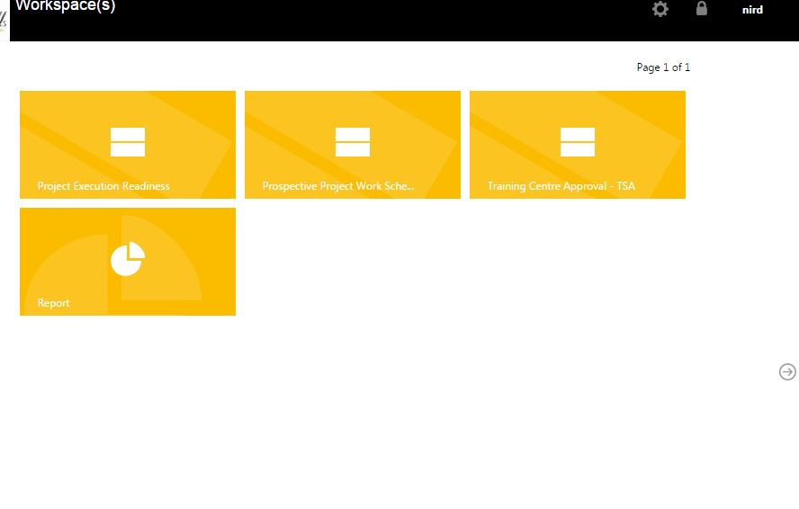
Enterprise Resource Planning Platform and interim arrangements (2/2)

Slide 20
THANKYOU

